Slide 1
Mobility, Policy, and COVID-19 Data in Prediction of Death Case Load
Sami Belhareth, Kshitij Pisal, Vasistha Vinod

Slide 2
Introduction
The COVID-19 pandemic has resulted in a significant loss of economic output and human life.
A means by which to accurately forecast the spread of the disease in relation to government policy is of critical importance when determining how to minimize both the spread of disease and economic impact.
The objectives of our study are to investigate the dependence of COVID-19-related deaths on the mobility habits of individuals and the government response data. We will investigate if there are differences in the effects of incorporating the mobility and government policy data for regions of varying population density.
We will train an LSTM model, evaluate its performance using the root mean squared error between the predicted number of deaths and the actual number of deaths, and compare it to an ARIMA model.

Slide 3
Motivation
Many parts of the world are yet to procure vaccines and administer to their citizens.
It is highly important to understand which policies are effective to curb the disease while causing minimum disruption to the daily lives of the citizens.
A data-driven approach can provide granular detail on the importance of restrictions that are the most responsible for stopping the spread of disease.
This allows policymakers to ease up on restrictions that hardly have any effect on the spread of the disease but do have economic impact.

Slide 4
Problem Definition
We will attempt to minimize the root mean squared error (RMSE) between the predicted number of deaths and the actual number of deaths using an LSTM network trained on one of the following combinations of input features:
cases, deaths, and mobility data.
cases, deaths and policy data.
cases, deaths, mobility data, and policy data.

Slide 5
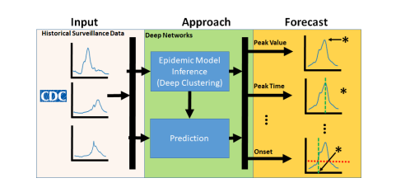
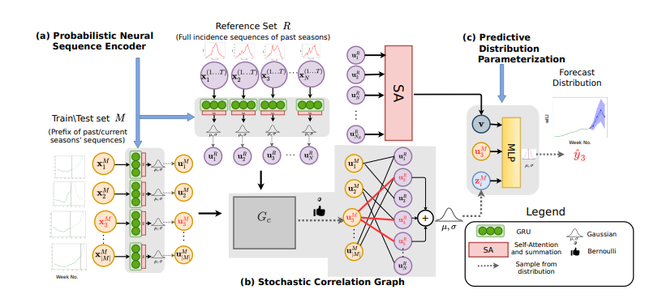
Related work and Survey
EpiDEEP makes use of neural networks to learn meaningful representations of incidence curves in a continuous feature space and accurately predict future incidences (Adhikari et al.)
EpiFNP is a functional neural process model, which models the forecasting task as a probabilistic generative process (Kamarthi et al. 2021)
LSTM models have been used to predict the spread of COVID-19 by incorporating meteorological and mobility data (Rashed & Hirata 2021)
Adhikari, B., Xu, X., Ramakrishnan, N., & Prakash, B. A. (2019, July). Epideep: Exploiting embeddings for epidemic forecasting. In Proceedings of the 25th ACM SIGKDD International Conference on Knowledge Discovery & Data Mining (pp. 577-586).
Kamarthi, H., Kong, L., Rodríguez, A., Zhang, C., & Prakash, B. A. (2021). When in Doubt: Neural Non-Parametric Uncertainty Quantification for Epidemic Forecasting. arXiv preprint arXiv:2106.03904.

Slide 6
Proposed Method: Intuition
Human mobility and government policy should both have significant impacts on the forecast of COVID-19 cases, as COVID-19 is transmitted via being near an infected individual, which an absence of mobility or strong government policy can both prevent.
However, the relationship between the effects of population density with human mobility and government policy is still unclear.
Seeing the success of deep learning models in forecasting, we wanted to determine how the deep learning models perform relative to simpler, non-machine learning algorithms.
We created ARIMA and LSTM models for comparison of traditional state of the art models with RNN models that have been proven to incorporate features to give better predictions.

Slide 7
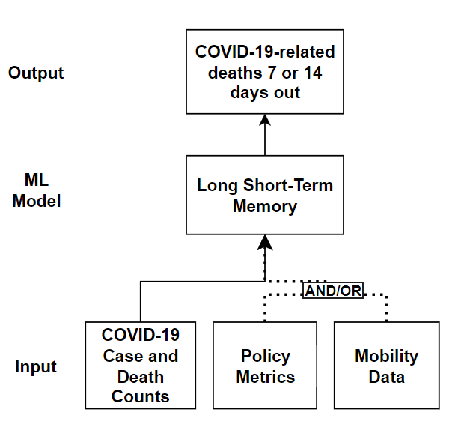
Proposed Approaches
Long short-term memory (LSTM) network
Inputs:
Apple mobility data
NYTimes COVID-19 case data
Oxford policy data
Outputs:
Forecast of COVID-19 cases and related deaths 7 days out
Forecast of COVID-19 cases and related deaths 14 days out

Slide 8
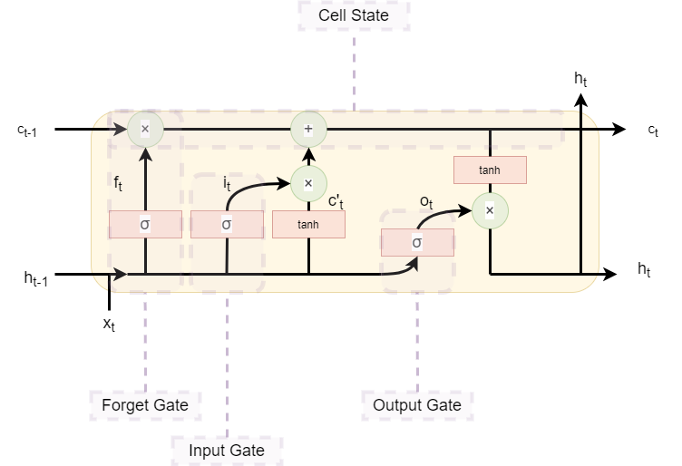
Proposed Approaches
Overview of the flow of information in an LSTM model.

Slide 9
Proposed Approaches
Hyperparameters:
Sequence Length for feature input = 14
Forecast lead = 7 (AND 14)
Learning Rate = 5e-5
Number of Hidden Units in LSTM = 40
Number of Epochs = 200
Number of Layers = 1

Slide 10
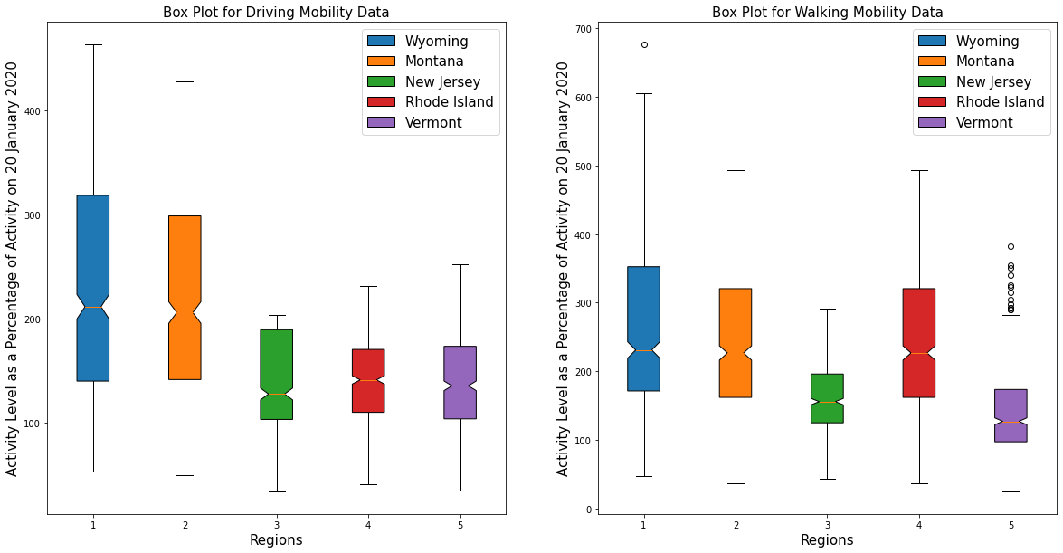
Data: Mobility

Slide 11
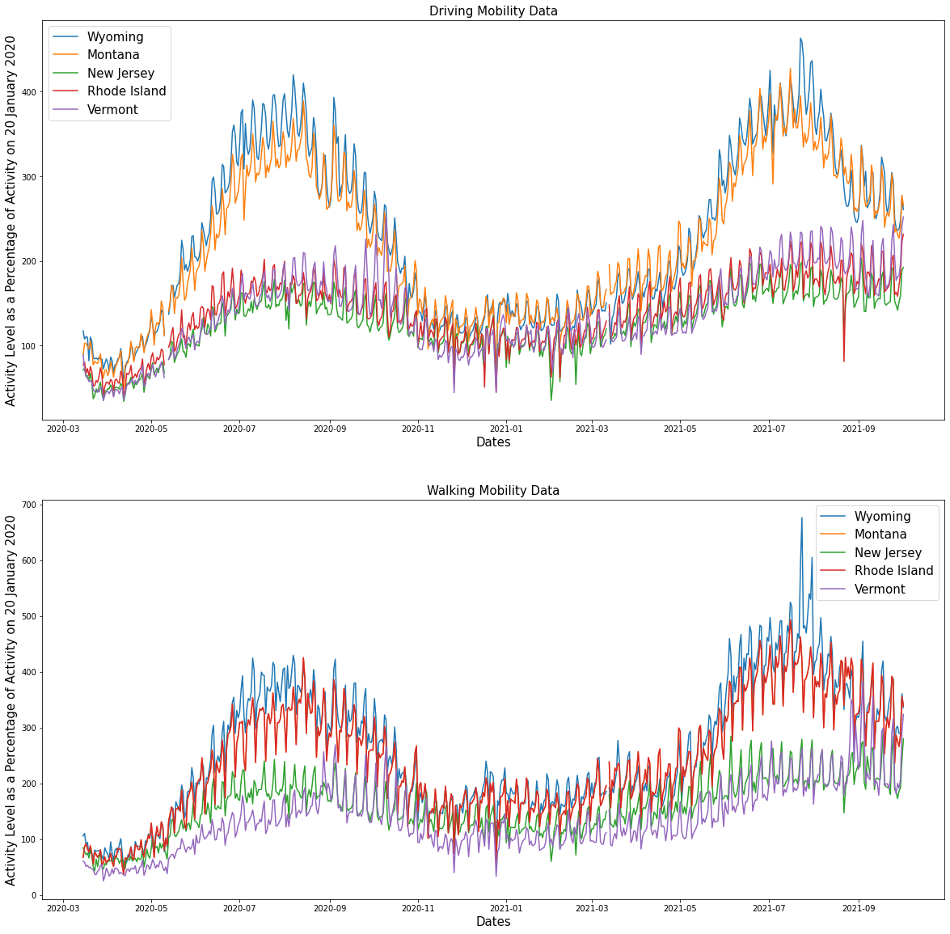
Data: Mobility

Slide 12
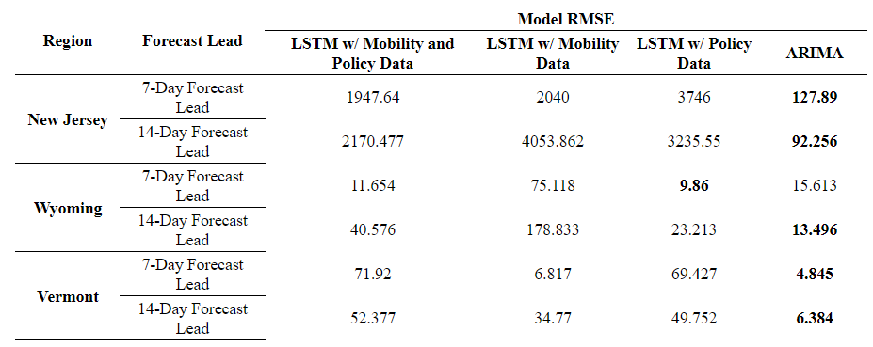
Results

Slide 13
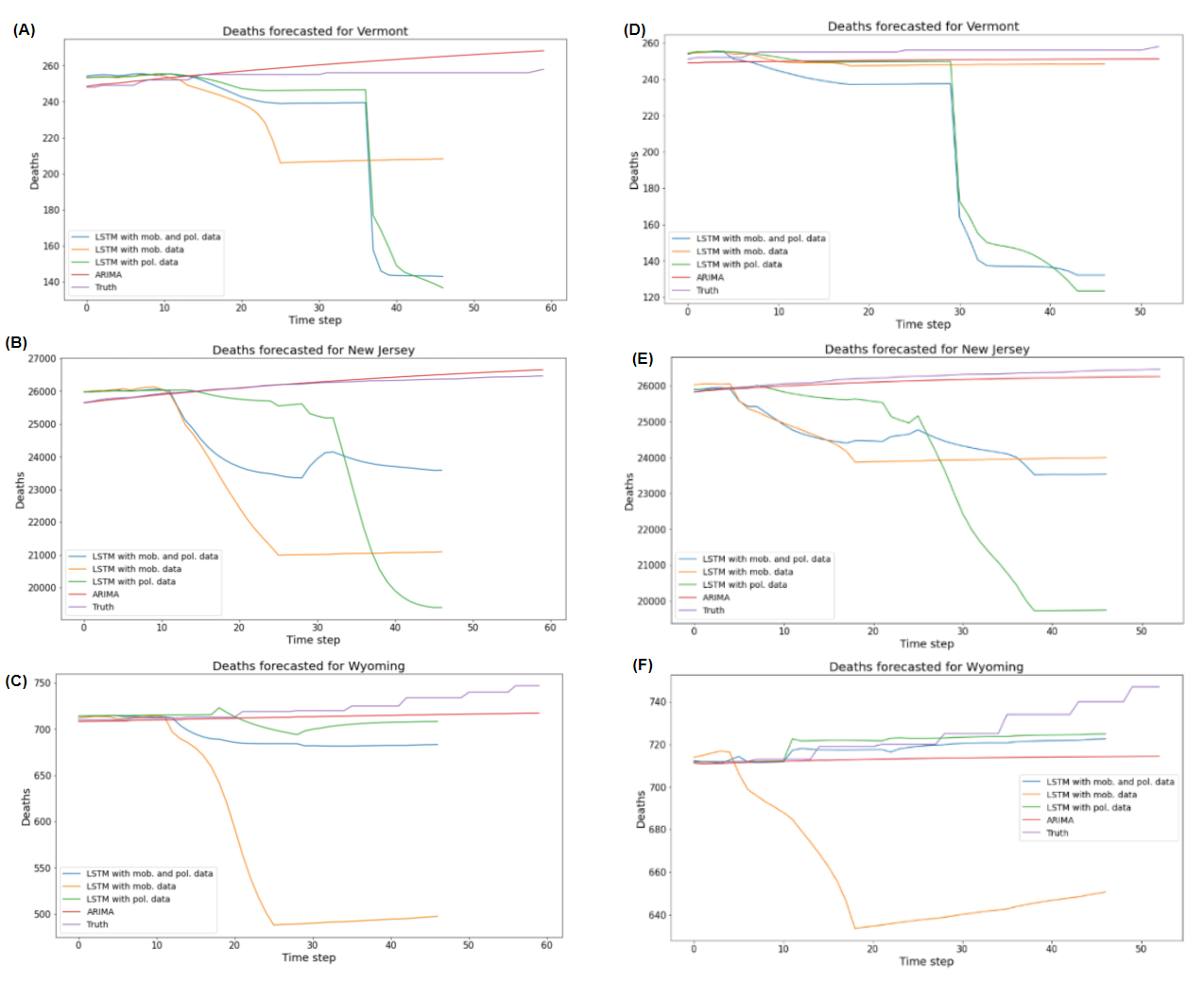
Results

Slide 14
Discussion
Due to the difficulties in obtaining high performance form LSTM models with a irregular time series dataset, we attempted to increase the features input in LSTM to determine if the model becomes more reliable than the simpler models, such as an ARIMA model.
In conjunction with the irregularity of the time series data, the additional input features reduced the model's ability to generalize over the testing set
The LSTM models with mobility data but no policy data tends to perform worse than the other models for most regions.
May indicate the size of the region over which we are attempting to forecast may be too large for a small number of mobility metrics to capture
Performance of the LSTM model with mobility data but no policy data may be improved if we were to forecast for a county or city.

Slide 15
Future Work
Reducing issues relating to the sparsity of data can be done through: imputing missing values, input augmentation, and time decay factors
Incorporate attention mechanism/ transformer models to improve the predictions
Increasing the granularity of the data may permit more accurate forecasting, as aggregating data for a large region may lead to a loss of region-specific relationships between the input features
Use linear regression to pad the data

Slide 16
Conclusion
The inclusion of the additional features — namely the mobility data and the policy data — does not lead to predictable increases in the performance of the LSTM model
Furthermore, the impact of their inclusion is different for each region
We discovered that traditional ARIMA models perform better than the LSTMs, particularly in regions where the population density is high

Slide 17
Thank You!

